Slide 1

“Energy Efficiency for
Server, Client, and
Embedded Systems”
By: Paul Yao, Principal,
Enovative Energy Solutions
www.EnovativeEnergy.com

Slide 2
Energy Efficiency Quiz (1 of 2)
(True or False)
1) Efficiency and Conservation are the same.
2) Electricity is a “clean” resource, with little or no environmental impact.
3) Efficiency makes no economic sense because electricity is cheap.
4) Computers are as efficient as they need to be.
5) When turned off, computers and monitors consume no electricity.

Slide 3
Energy Efficiency Quiz (2 of 2)
(True or False)
6) Leaving computers turned on uses less energy than turning them on and off.
7) Turning computers on and off causes them to wear out faster.
8) Screen savers save both pixels and power.
9) Energy efficiency of computer systems is a hardware problem. Hardware components dictate power consumption. Nothing – by software or users – increases energy efficiency.
10) Servers cannot be made more energy efficient than they already are.

Slide 4
Efficiency and Conservation
FALSE
1) Efficiency and Conservation are the same.
Conservation is “doing less with less”
Efficiency is “doing more or the same with less… could wipe out one fifth to one third of the world's energy consumption with:
  More efficient appliances
  More efficient lighting
  More efficient factories
  More efficient buildings”
Source: Foreign Policy Magazine, Seven Myths About Alternative Energy, August 24, 2009.

Slide 5
Is Electricity Clean?
TRUE –and- FALSE
2) Electricity is a “clean” resource, with little or no environmental impact.
  FALSE – In 2008, 70.3 generated by fossil fuels:
    Coal (46.9%)
    Natural Gas / Other Gas (22.2%)
    Petroleum (1.2%)
  TRUE – In 2008, 9.4% generated by…
    Hydroelectric (6.2%)
    Other Renewable (3.2%)
  ➔What About Nuclear (20.1%)?
Source: Energy Administration, US Dept of Energy

Slide 6
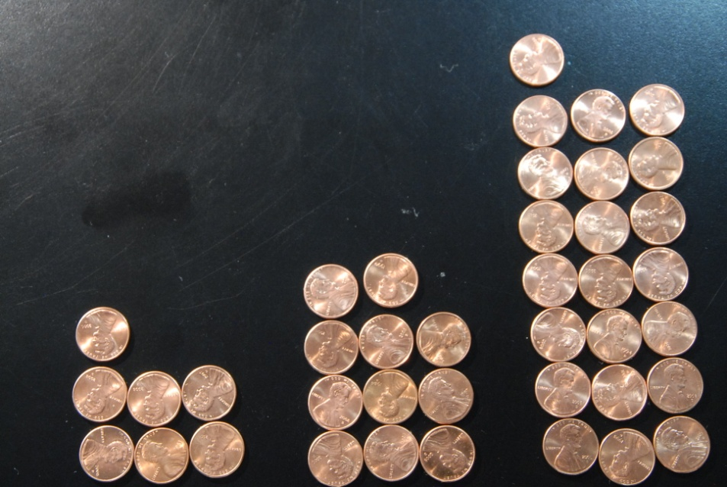
Economic Impact of Efficiency
FALSE
3) Efficiency makes no economic sense because electricity is cheap.
US Residential Electricity Rates – May 2009
          7.37 11.86 22.04
          (Idaho) (Avg) (Hawaii)
Source: Energy Administration, US Dept of Energy
Cents Per
Kilowatt
Hours

Slide 7
Economic Impact of Efficiency
FALSE
3) Efficiency makes no economic sense because electricity is cheap.
Table of kWh | Hours | 1 Watt | 10 Watts | 100 Watts | 1000 Watts
1 Day = | 24 | 0.024 | 0.24 | 2.4 | 24
1 Week = | 168 | 0.168 | 1.68 | 16.8 | 168
1 Month = | 720 | 0.72 | 7.2 | 72 | 720
1 Year = | 8760 | 8.76 | 87.6 | 876 | 8760

Slide 8
Economic Impact of Efficiency
FALSE
3) Efficiency makes no economic sense because electricity is cheap.
11.86 / kWh | Hours | 1 Watt | 10 Watts | 100 Watts | 1000 Watts
1 Day = | 24 | $ 0.0028 | $ 0.03 | $ 0.28 | $ 2.85
1 Week = | 168 | $ 0.02 | $ 0.20 | $ 1.99 | $ 19.92
1 Month = | 720 | $ 0.09 | $ 0.85 | $ 8.54 | $ 85.39
1 Year = | 8760 | $ 1.04 | $ 10.39 | $ 103.89 | $1,038.94

Slide 9
Economic Impact of Efficiency
Give Computers Evenings & Weekends OFF
Table of kWh | Hours | 1 Watt | 10 Watts | 100 Watts | 1000 Watts
1 Year | 8760 | 8.76 | 87.6 | 876 | 8760
1 ManYear | 2080 | 2.08 | 20.8 | 208 | 2080
11.86 / kWh | Hours | 1 Watt | 10 Watts | 100 Watts | 1000 Watts
1 Year | 8760 | $ 1.04 | $ 10.39 | $ 103.89 | $1,038.94
1 Man Year | 2080 | $ 0.25 | $ 2.47 | $ 24.67 | $ 246.69

Slide 10
Are Computers Efficient?
TRUE –and- FALSE
4) Computers are as efficient as they need to be.
TRUE
  Laptop computers in particular are very energy efficient.
  LCD monitors are generally efficient; many have smart default sleep settings.
FALSE
  Server systems are not particularly efficient.
  Desktop systems are not particularly efficient.

Slide 11
Consume Energy When Off?
FALSE
5) When turned off, computers and monitors consume no electricity.
Even “off”, desktop systems can consume 5-10 watts
Even “off”, monitors can consume 1-5 watts
➔ 6 to 15 watts = $6 to $15 / year

Slide 12
Always On vs. On & Off
FALSE
6) Leaving computers turned on uses less energy than turning them on and off.
Computer Power Usage:
  On: 125 – 135 watts
  Stand-By: 115 watts
  Hibernate / Off: 6 watts
Monitor Power Usage:
  On: 18 watts
  Standard-By: 1 watt
  Off: 1 watt

Slide 13
Wear and Tear
FALSE
7) Turning computers on and off causes them to wear out faster.
PCs are designed to handle 40,000 on/off cycles before failure
Hard drive heads automatically park on power down

Slide 14
Screen Savers Helpful?
FALSE
8) Screen savers save both pixels and power.
Pixels:
  CRTs need screen savers
  LCSs do not need screen savers
Power
  Some screen savers prevent lower power modes (Stand-By / Hibernate)
  3D screen savers may cause increased power usage by some graphics cards.

Slide 15
Hardware Problem?
FALSE
9) Energy efficiency of computer systems is a hardware problem. Hardware components dictate power consumption. Nothing – by software or users – increases energy efficiency.
Elements of energy efficiency:
  Hardware
  Software = operating system + drivers + applications
  People

Slide 16
Server Energy Efficiency
FALSE
10) Servers cannot be made more energy efficient than they already are.
Individual Servers
  Lower clock speed = less energy used
  Time of day availability
  Selective hardware “sleep” modes
Server Clusters
  Virtualization enables consolidation

Slide 17
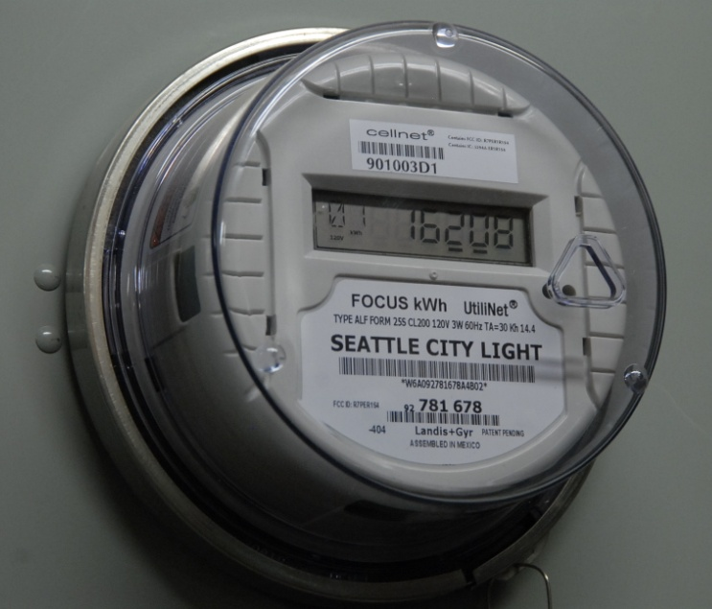
Measuring Electricity Usage
Utility-Provided Resources
  Monthly (or semi-monthly) Bill
  Online Usage Information
  The Meter
Power Meters
  Low-Cost: Kill-A-Watt
  At the Panel: TED

Slide 18
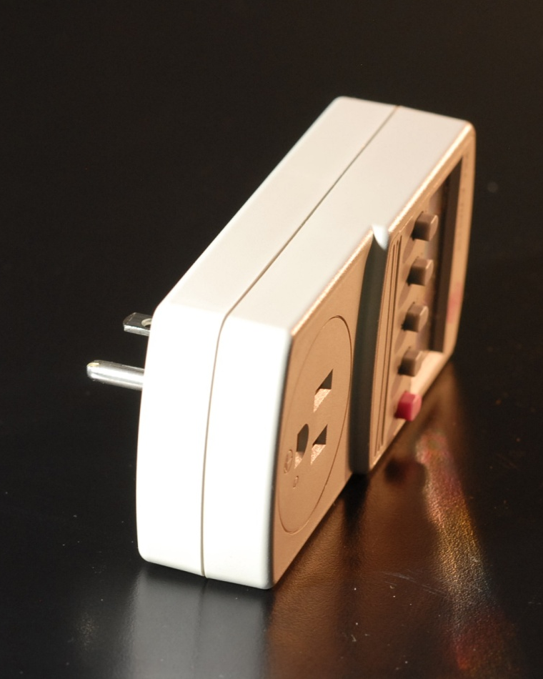
Measuring Electricity Usage
Kill-A-Watt
Power meter for:
  Volts
  Amps
  Watts
  Hz
  kWh (cumulative)
Inexpensive ( < $30)

Slide 19
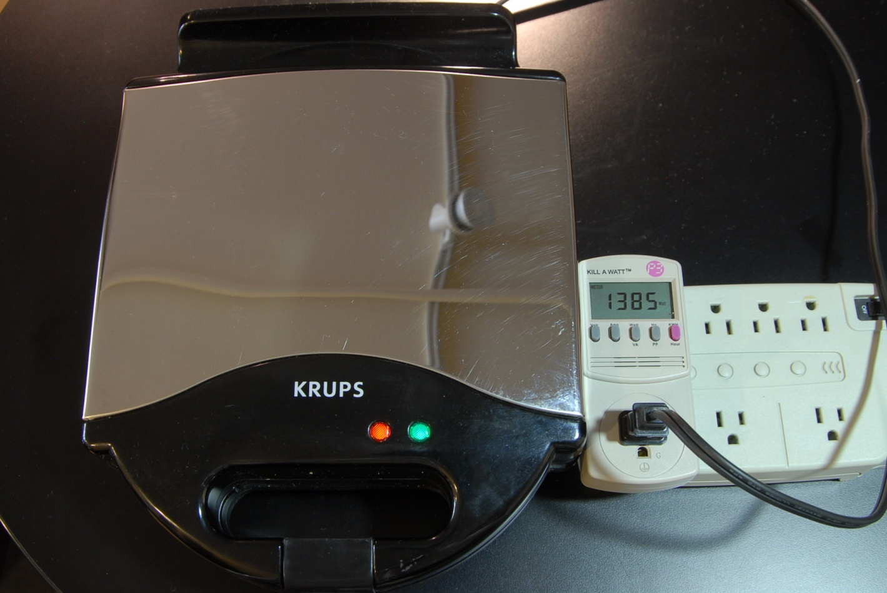
Measuring Electricity Usage
Kill-A-Watt
Use Kill-A-Watt for:
  Any 2 or 3-prong
  appliance
  US Power (120 volts)
  Max 1875 watts
Example:
  Waffle Iron
  1300 – 1400 watts

Slide 20
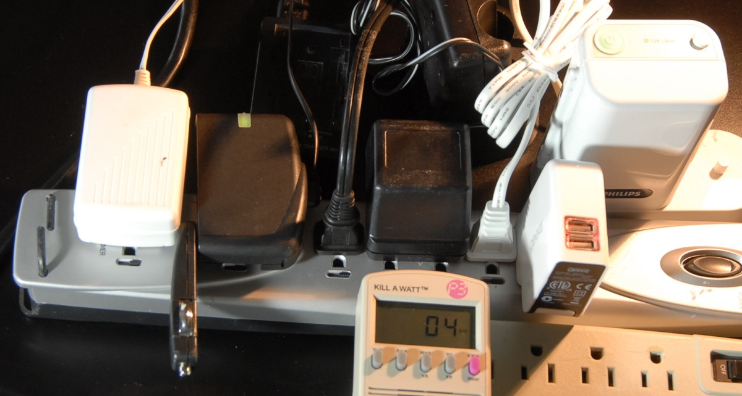
Measuring Electricity Usage
Kill-A-Watt
Phantom (vampire) power loss
  Power usage on devices turned OFF
  Power usage on chargers
  One fix: Unplug
  Another fix: Use a power strip and turn OFF
How much is lost?
  Minimal loss with
  latest chargers
  Six chargers use
  four watts
  (see figure)

Slide 21
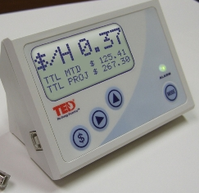
Measuring Electricity Usage
TED – The Energy Detective
Install in Electrical Panel
Captures data for:
  Entire home / office floor
  Individual circuit
Supports download data to PC
  Requires FOOTPRINTS –
  data logging software
  Download data via USB cable
MSRP:
  Ted 1001 - $120
  Ted Footprint Software - $50

Slide 22
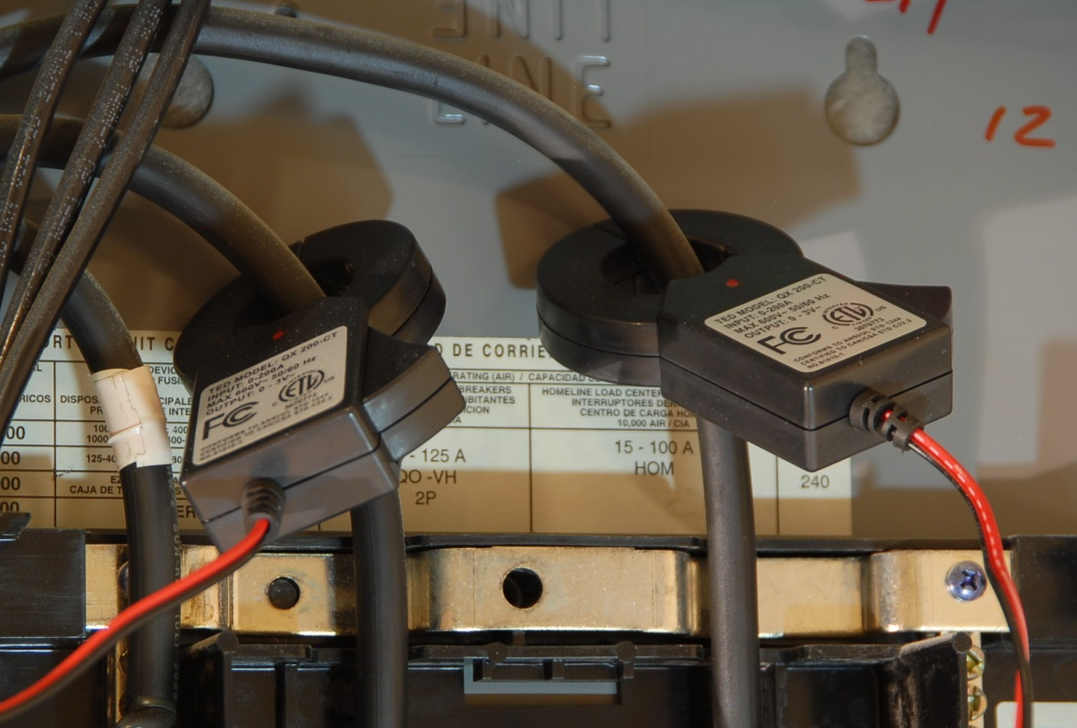
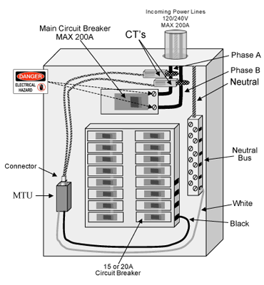
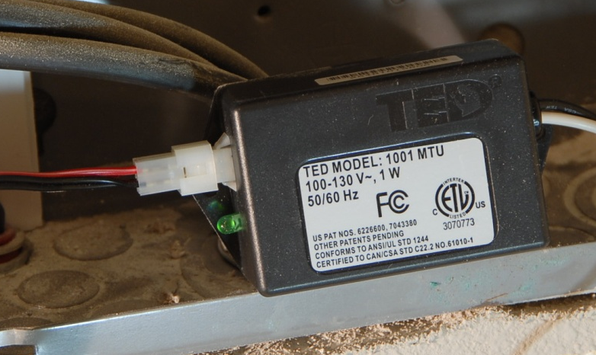
Measuring Electricity Usage
TED – The Energy Detective
Installing TED in
circuit breaker panel

Slide 23
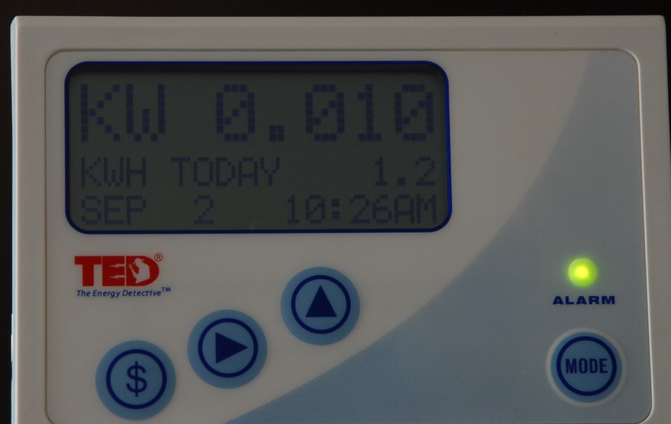
Measuring Electricity Usage
TED – My Condo’s ‘basal’ metabolism

Slide 24
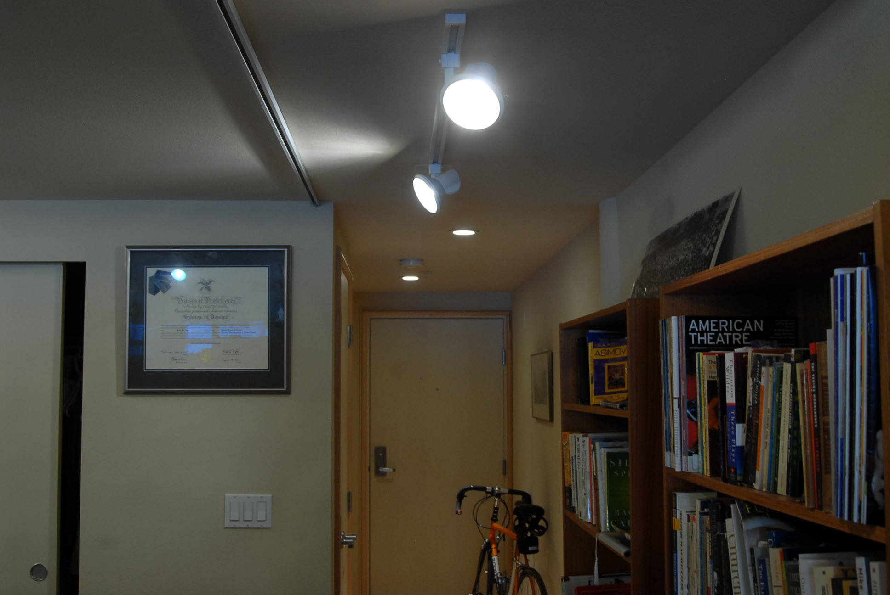
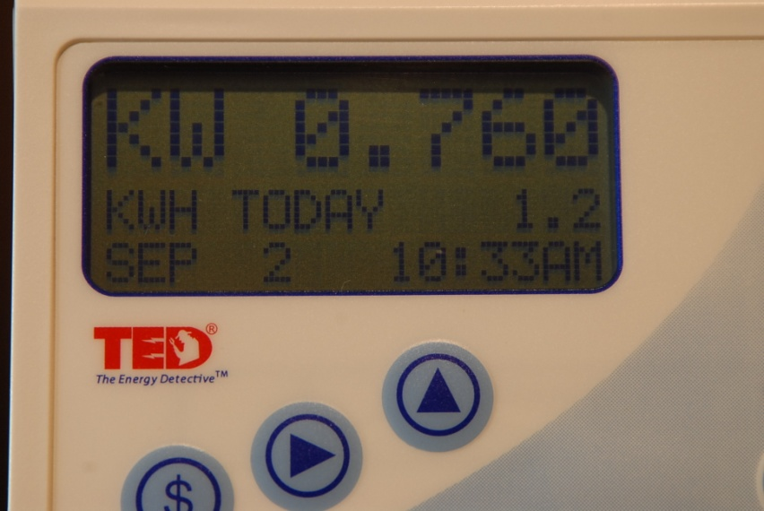
Measuring Electricity Usage
TED – Turning All Lights On

Slide 25

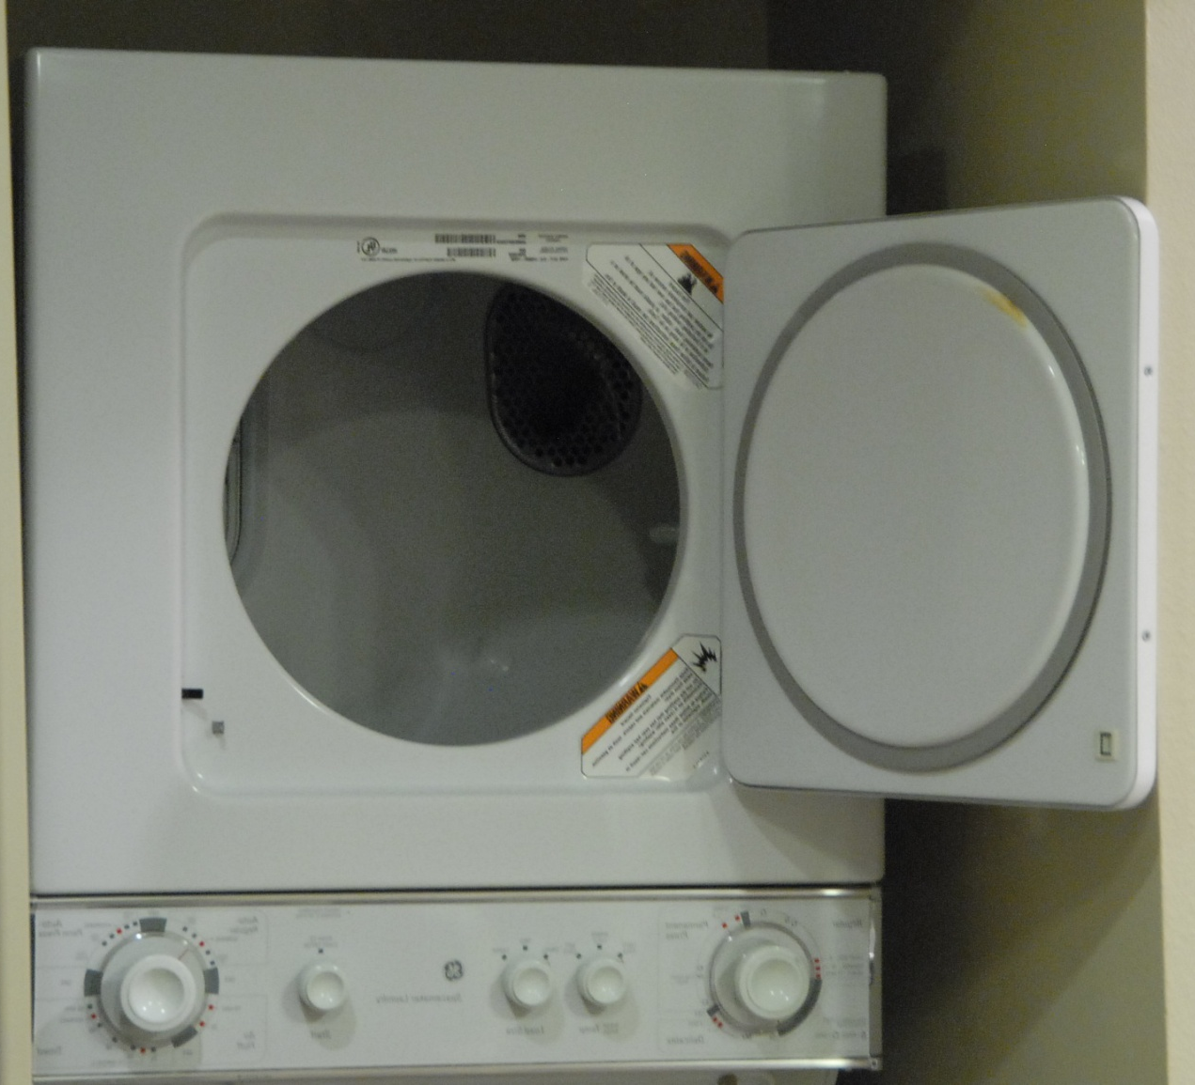
Measuring Electricity Usage
TED – Add the Clothes Dryer

Slide 26
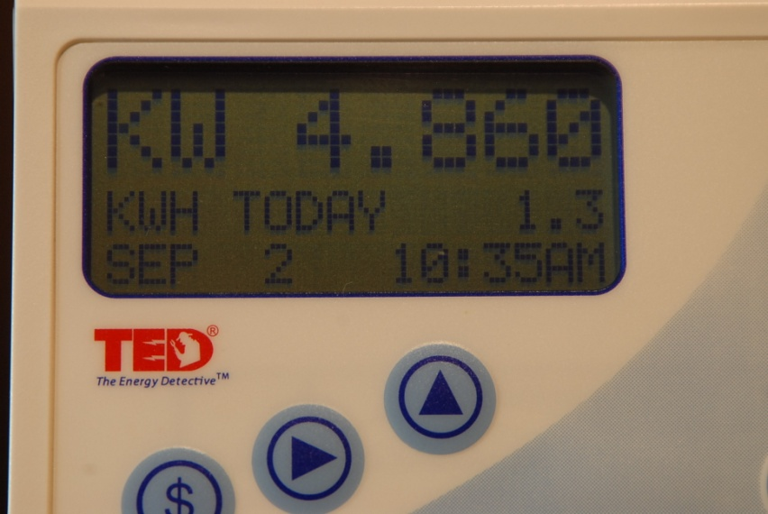
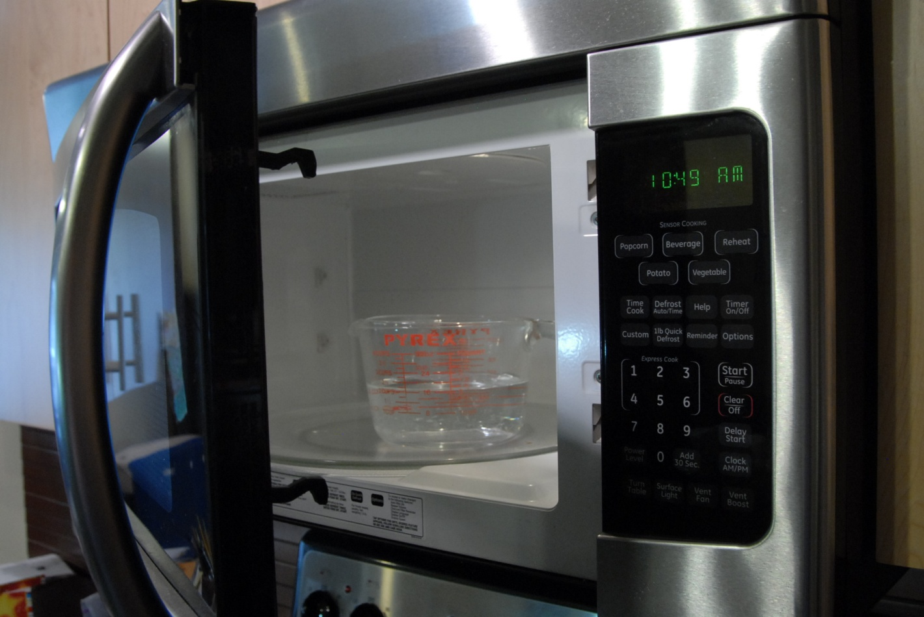
Measuring Electricity Usage
TED – Add Microwave Oven

Slide 27

Measuring Electricity Usage
TED – Add Waffle Iron

Slide 28

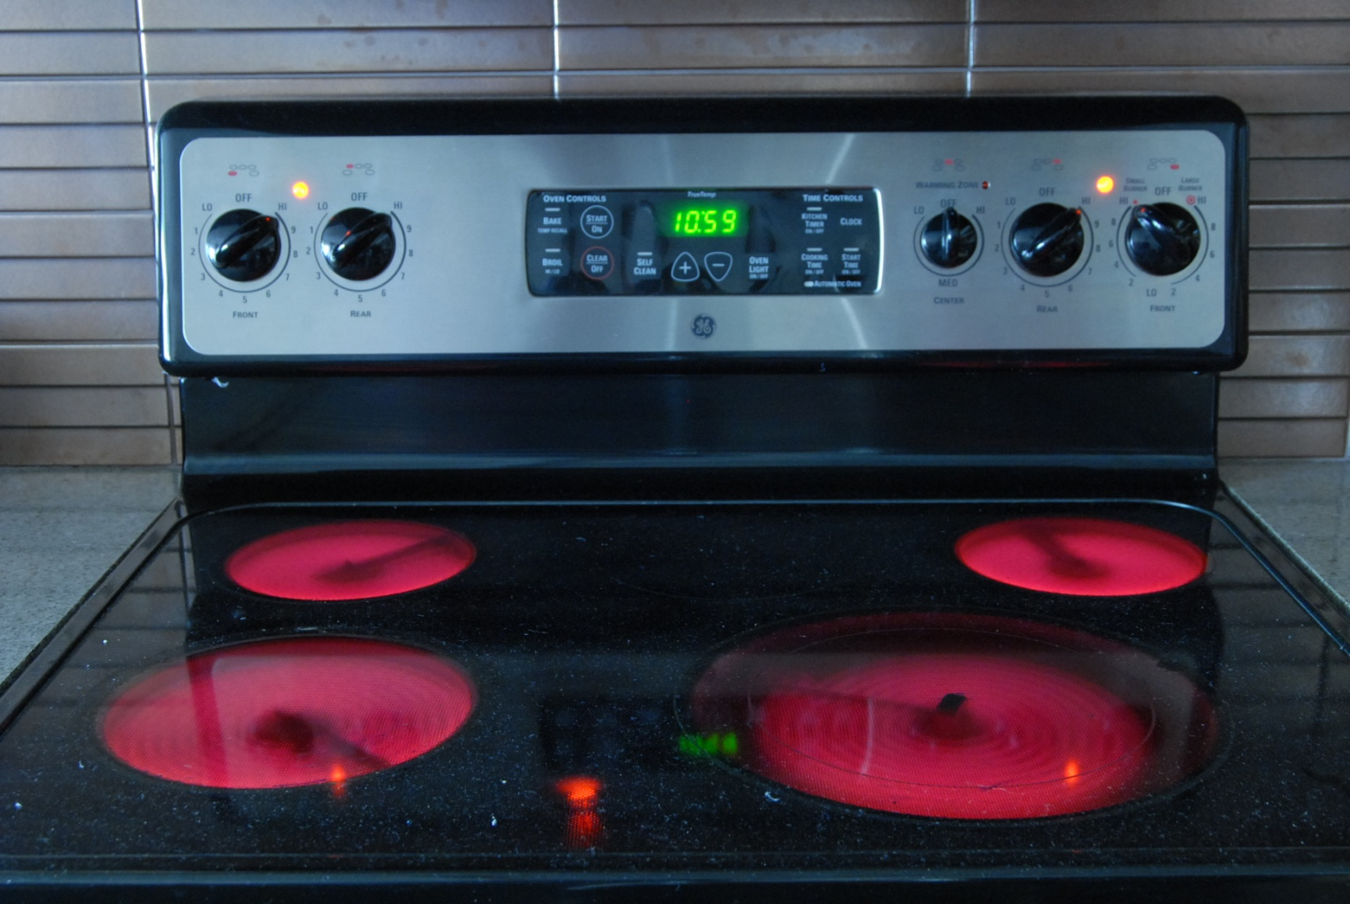
Measuring Electricity Usage
TED – And Four-Burners of Electric Stove

Slide 29
Computer Energy Efficiency
Tips
Computer Lifecycle:
  1) Acquisition (Design)
  2) Configuration
  3) Operation
  4) Retirement
Source: www.enovativenergy.com

Slide 30
Computer Energy Efficiency
1) Acquisition
Prefer laptops over desktop systems
Consider Energy Star rating: www.energystar.gov
Consider EPEAT rating: www.epeat.net

Slide 31
Computer Energy Efficiency
2) Configuration
Use fewer RAM modules
  1 x 4GB module uses less power
  4 x 1GB modules use more power
Enable Power Management
  Stand-By: Some savings, fast restore
  Hibernate: Greatest savings, slower restore
Automate Power Management
  Faronics Power Save (www.faronics.com)

Slide 32
Computer Energy Efficiency
3) Operation
Run systems at slower clock speed
  Windows CE BSP Developers – Allow customers to control CPU clock speed
Evenings & Weekends
  Hibernate (or Shut Down)
  Use Power Strip to shut off ALL power

Slide 33
Computer Energy Efficiency
4) Retirement
Dispose of systems properly (at approved recycle center)
Retire CRT monitors in favor of LCDs
Measure power usage & retire electricity-hungry computers earlier

Slide 34
“Energy Efficiency for
Server, Client, and
Embedded Systems”
By: Paul Yao, Principal,
Enovative Energy Solutions
www.EnovativeEnergy.com

